Slide 1
USDA ERS/Blackknight
Evaluating Broadband Subsidy Programs
Josh Goldstein, Neil Kattampalil, Leonel Siwe
USDA ERS Sponsor: John Pender
Social and Decision Analytics Division (UVA-SDAD),
Economic Research Service-U.S. Dept. of Agriculture.
Data Science for Public Good 2023

Slide 2
Motivation
Broadband investment is a high priority for the Administration
and Congress
Little research has investigated the economic impacts of broadband programs
Over $3 billion in funding FY2019-2023 for rural broadband through the ReConnect program

Slide 3
Data Sources and Methods
Data sources that reflect the effects of broadband
    BlackKnight: Property Values and Housing Characteristics
    Ookla Data
    American Community Survey (ACS): Demographic variables
    RUS Program boundary and associated shapefiles
Modeling broadband adoption rates and subscription speeds down to the household level

Slide 4
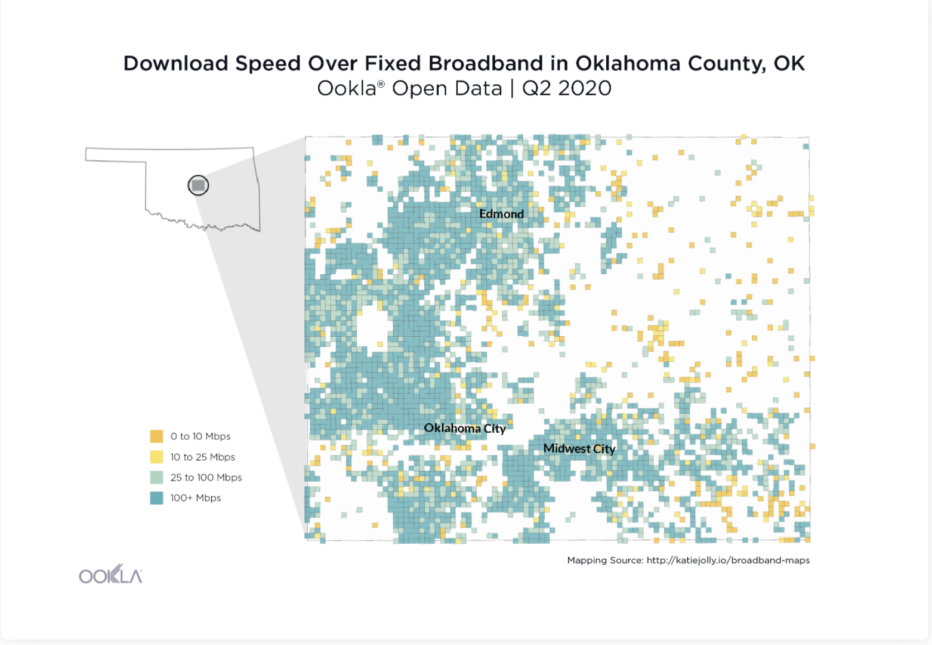
Ookla Data and the ReConnect
Linking the ReConnect program with Ookla Download speed data
600 sq. ms sized grid over which data is recorded

